Slide 1
Welcome to Year 1
Teachers – Mrs Turner, Miss Hirst, Miss Wight, Miss Butunoi
Teaching Assistants – Mrs Hillyard, Miss Gorman, Mrs Tamcken, Miss Morgan and Mr French
PPA Cover – Miss Harris (1B) and Mrs Turner (1W)
Notes:
HT

Slide 2
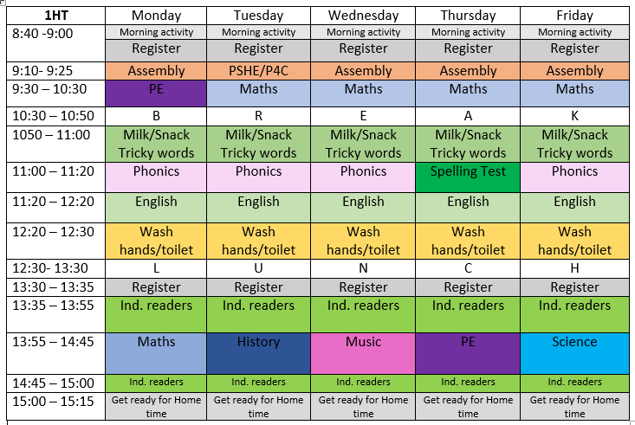
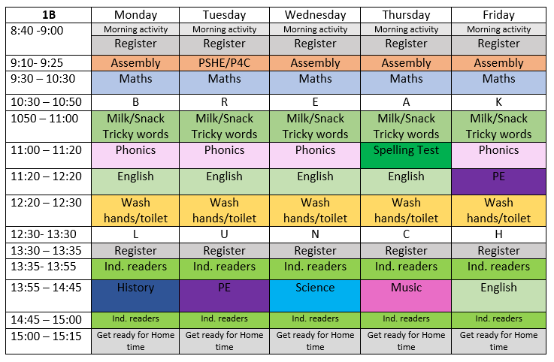
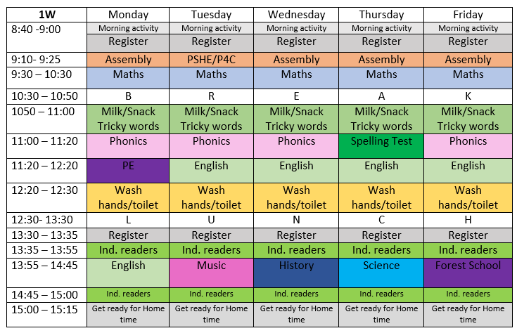
Our Class Timetables
Notes:
SH

Slide 3
The beginning of Year 1
The children have had a brilliant start to Year 1.
We began the first full week working through various assessments to ensure our planning is tailored to the children needs.
The children have had PSHE lessons in which they have had to think about what would make the perfect learning environment and created class rules for them all to follow
It has been a great opportunity to get to know the children more and allow them to settle into their new classrooms.
Notes:
HT

Slide 4
Maths
Teacher’s assess children before teaching the Y1 curriculum objectives
Work is set specifically for the children’s needs and we work through them at a pace appropriate to them
Maths Targets in Autumn Term will include: Place value, addition, subtraction, money, 2D and 3D shapes
Notes:
RB

Slide 5
Phonics
We have assessed the sounds the children know and are currently revisiting some sounds
We will be teaching in sound families so will have a sound of the week for children to explore
Spelling tests (5 sound of the week and 5 common exception words) will be every Thursday
Spelling books will be kept in book bags
These will start in a couple of weeks
Notes:
LW

Slide 6
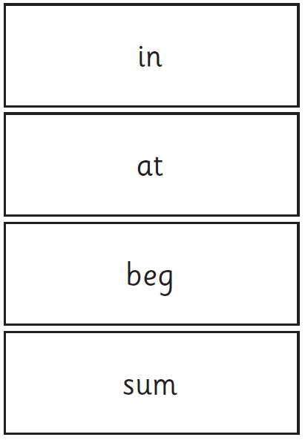
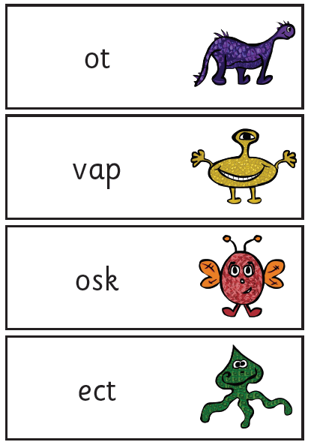
Phonics Screening Check
Your child will have a phonics screening check in June. This is a national test set by the government.
There will more information and support packs sent home nearer the time.
They will be assessed on their ability to segment and blend real and pseudo/nonsense words.
You will be given a copy of their results in your child’s report in the summer.
The children will be familiar with these tests, as we will do several practise ones throughout the year.
Notes:
HT

Slide 7
English
Learn a text through “talk 4 writing”
Orally rehearse the text with actions to help internalise
Learn skills from the model text and use them in our own writing
Respond to feedback – both verbal and SPAG marking
Innovate the text
Poetry, story (journey/quest and defeating the monster), non-fiction (instructions and non-chronological report).
Embed basic skills such as handwriting, punctuation, use of sounds/spelling.
Notes:
LW

Slide 8
Reading
1:1 with Teacher/TA
Extra with volunteers
Will focus on using sounds to decode words
Deepen children’s understanding of the texts they are reading
Linked to this, children may be encouraged to keep a book they have read to concentrate on answering questions about it.
In the new year we will begin reciprocal reading/“book club!”
Notes:
SH

Slide 9
3D Curriculum
Attack and Defense – Year One focus “Remembrance”
Engaging, fun and exciting!
Knowledge based against the Year 1 curriculum
Learning about Remembrance Day, Animals and Humans in Science. Creating their own clay Poppies and exploring different faiths in RE.
Notes:
RB

Slide 10
PSHE/P4C
We will continue to enjoy circle time activities as a class
We will continue to focus on new beginnings, relationships with family and friends, kindness and anti-bullying
We will also begin to conduct philosophical enquiries where we will think and reason as a group
Notes:
SH

Slide 11
PE
1HT – PE on a Monday and Thursday
1W – PE on a Monday and Forest School on Friday
1B – PE on a Tuesday and Friday
This term we will be using the outdoors to participate in athletic activities – relays with bean bags, team games and throwing and catching
We are also focusing on the social aspect of Real PE – taking turns, praising and encouraging others
We will also be learning new ways of travelling and rolling in gymnastics, working towards creating a sequence.
Forest School for 1HT in Spring 1 and 1B in Autumn 2
Notes:
LW

Slide 12
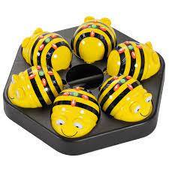
ICT
Coding with BeeBots
Then, coding using Espresso on iPads
Notes:
RB

Slide 13
Homework
Support with reading books at home. Please ensure you write in the yellow reading diary
Phonics weekly spellings. Will be sent home Thursday ready for the spelling test the following Thursday
Alternating Maths, English and Theme homework to support their targets in class (starting this week)
If their books need changing their book bags go into the ‘books to be changed’ box. Otherwise, they go into their coloured drawers.
Notes:
HT

Slide 14
UNITED
BCPA value the development of the whole child and supporting other life skills.
The acronym UNITED stands for:
Undertaking investigations, information gathering, team work, evaluation and determination.
We will embed these skills at every opportunity.
Notes:
SH

Slide 15
Class DoJo
Sign up to see how many house points your child is achieving
Notifications of when your child achieves GOLD
To share any WOW moments that have happened outside of school.
Any other communication please contact the office.
Notes:
LW

Slide 16
Thank you ☺
Notes:
HT

